Slide 1
Project Architecture
??? -> Profit
Devin Bidstrup, George Sorescu, Allen Zou,
Eric Rivera, and Sam Krasnoff

Slide 2

Quick Intro to Gamemaker
Proprietary Language - owned by a company and is not open source
Specifically optimized for making 2D games
The preset functions make the game less abstract and limits opportunities to personalize the game
Many very successful games have used Gamemaker, one of them being Undertale
In place of C++ classes, it utilizes “classes” such as sprites, rooms, and objects

Slide 3
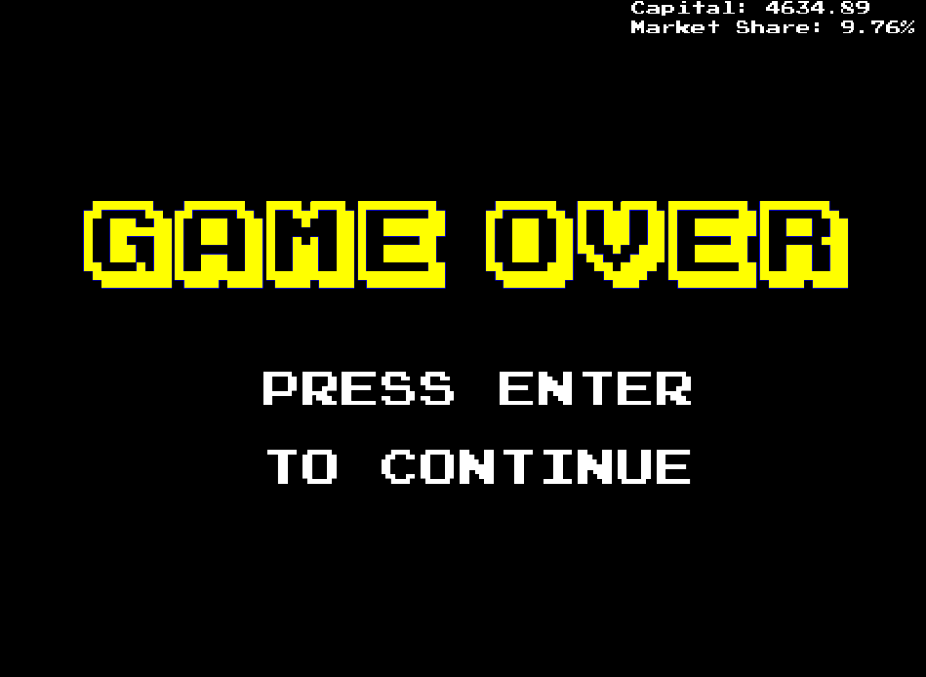
Score System
Two global variables:
marketshare
capital
You lose when
you drop < 10% starting capital
You win when
all three deadlines reached
market share > other companies
Every action from the main menu room will alter both the market share and capital in the backend
Notes:
The goal of the game right now is to play for as long as possible

Slide 4
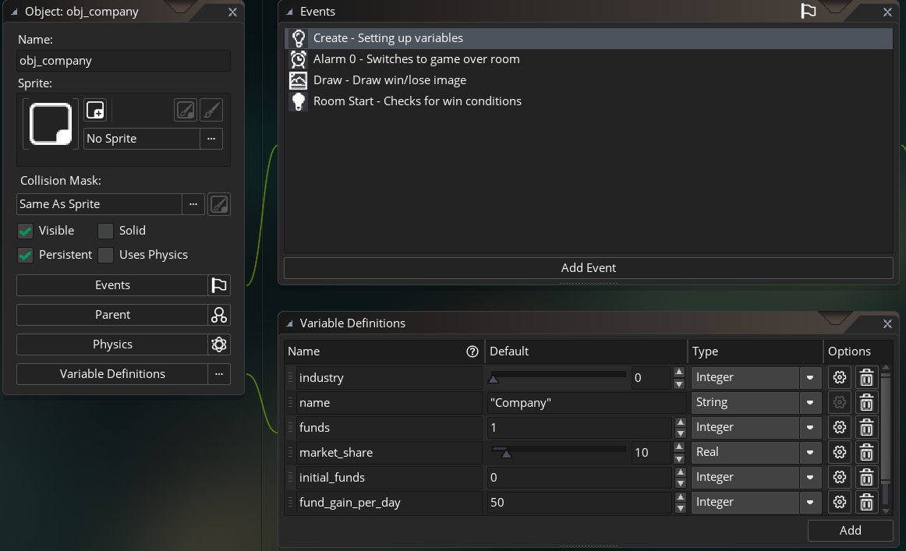
Persistent Background Objects
obj_company
industry_enums
obj_company_other1
obj_compant_other2
obj_rooms
room_enums
obj_fundsANDmarket

Slide 5
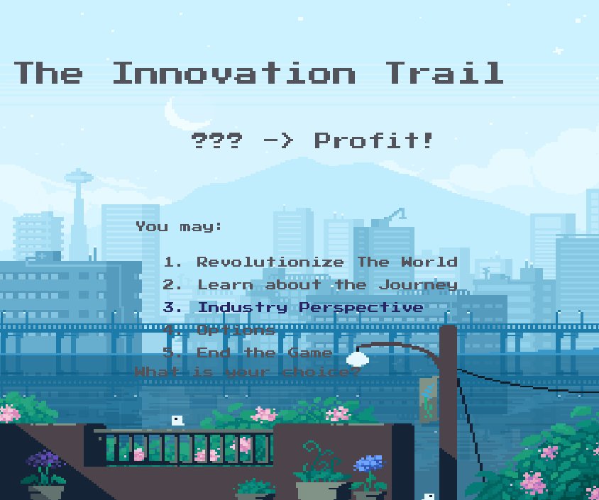
Initial Setup
Initial screen that users see when they open the game
Displays game logo and buttons options
Users navigate the menu using up and down arrow keys
Clicking a button redirects the user to a different corresponding room

Slide 6
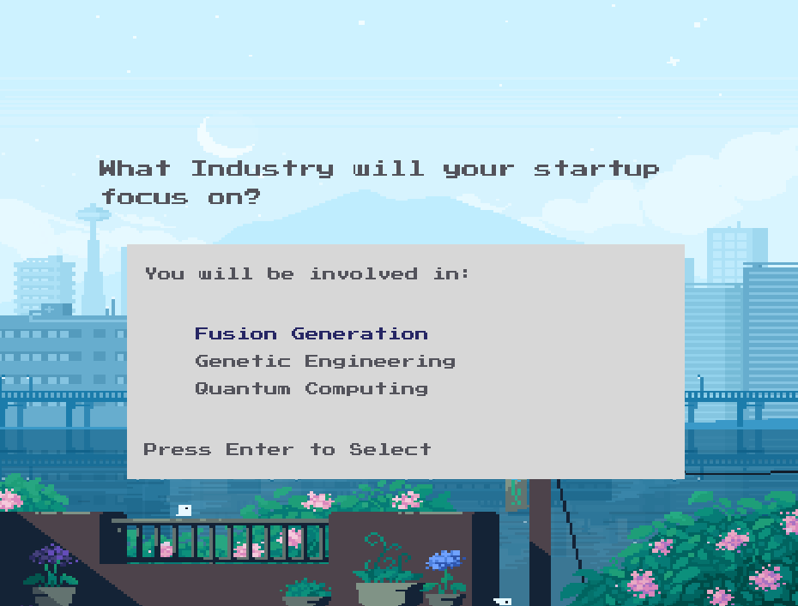
Main Menu
User reaches this screen by clicking “Revolutionize The World”
Allows user to choose industry
Clicking the buttons navigate the user to research and investments
Choosing specific fields give different initial values in the game

Slide 7
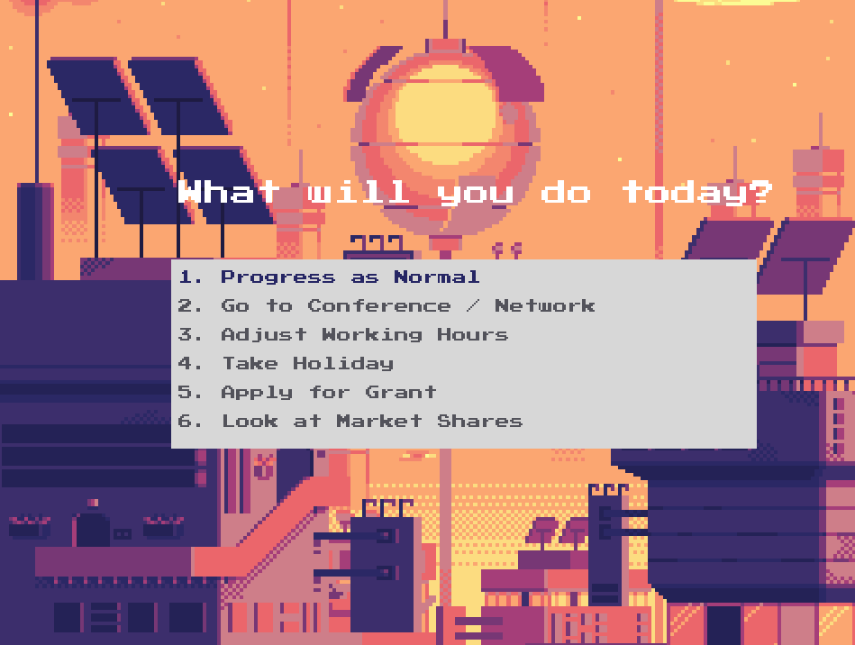
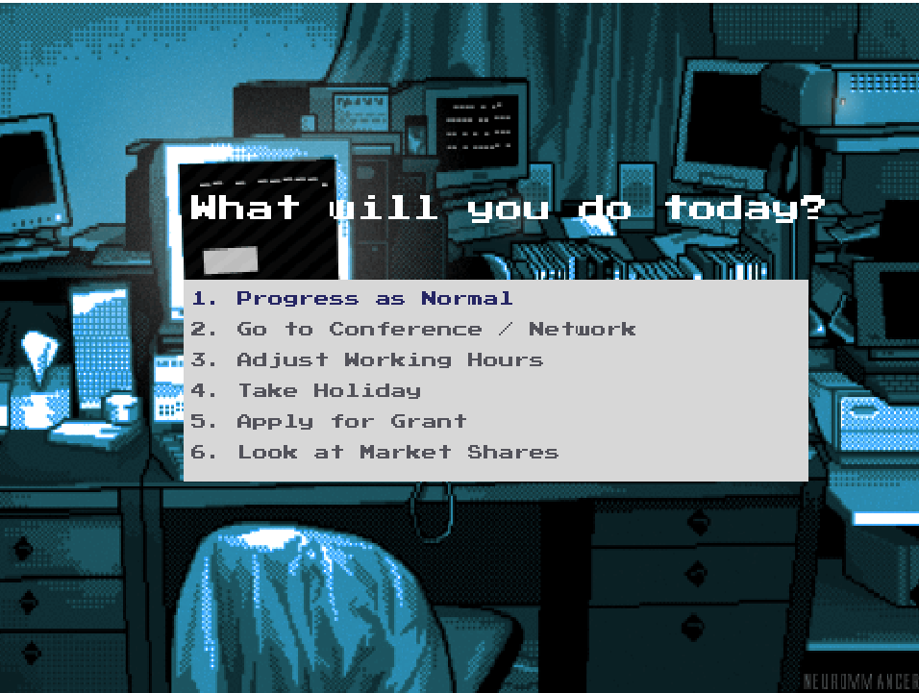
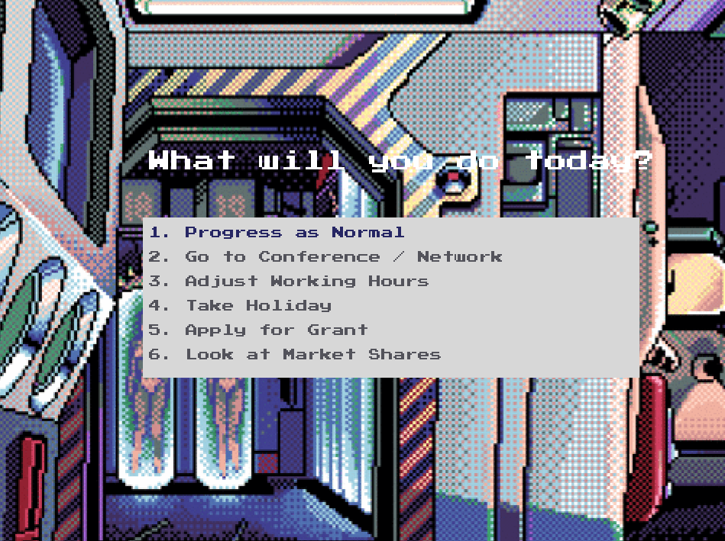
Game Menu
The user moves to this room after choosing research and investments
Using a “background” object and an if statement which checks the variable obj_company.industry, the room can change location with a draw statement
Users can then select their task for the day by clicking a button

Slide 8
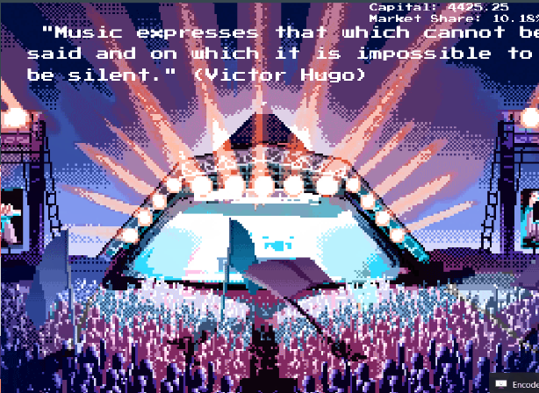
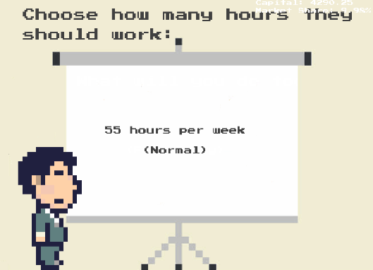
Adjust Working Hours & Vacation
Each “day,” the user can choose to adjust working hours or go on a vacation
Each decision will change the global score variables
Options for adjusting working hours:
40 hours (easy peezy)
55 (normal)
80 (inhumane) these are the working hours

Slide 9
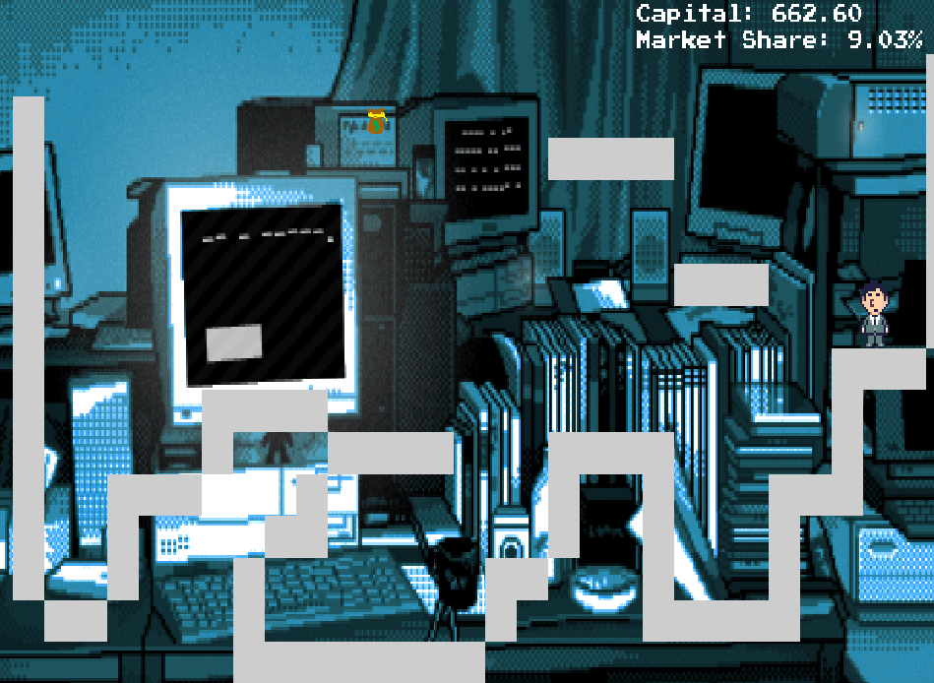
Grant Minigame
User reaches room by clicking
The user controls a sprite that collects money bags around the map
Upon creation, a global time variable is initialized
Time is incremented using room speed
User wins when all bags are collected
Stats in the main game increase depending on how fast the user wins the minigame

Slide 10
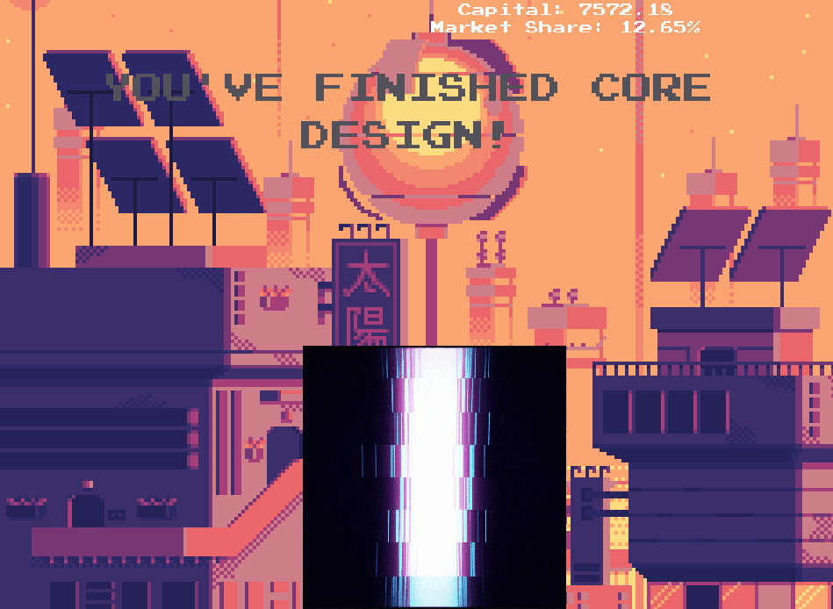
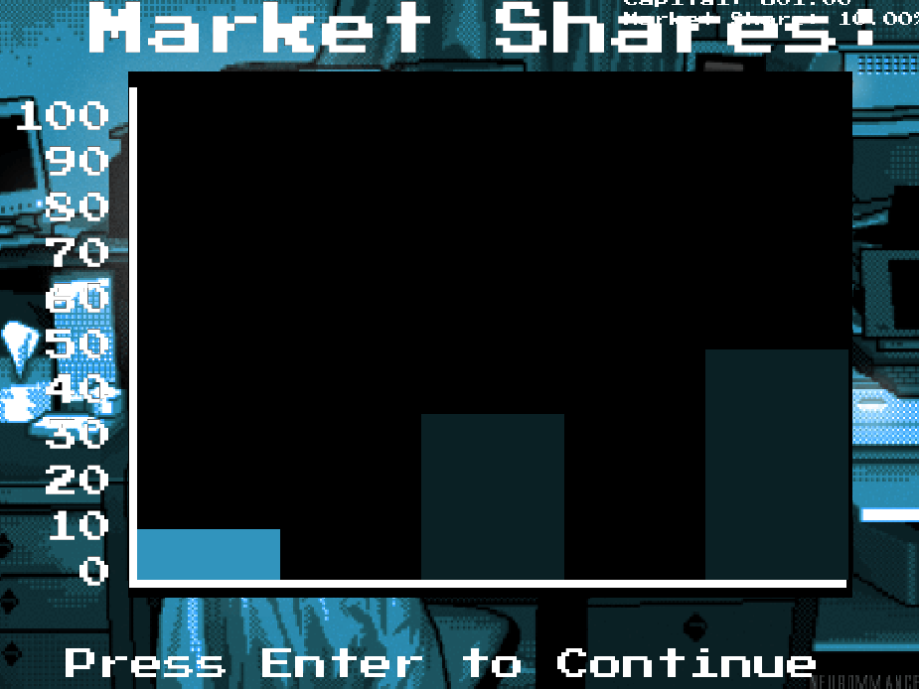
Other Kewl Functionality
Major accomplishments
Market Share Analysis

Slide 11
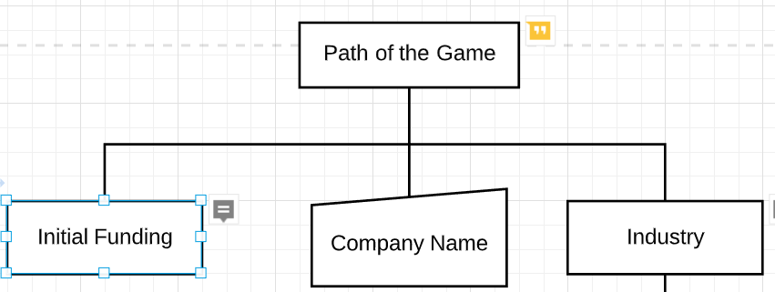
General Structure of the Game
When the user commences he/she must name the company, select industry, and is provided with initial funding.
With the resources available the user must complete a series of objectives to increase market cap.

Slide 12
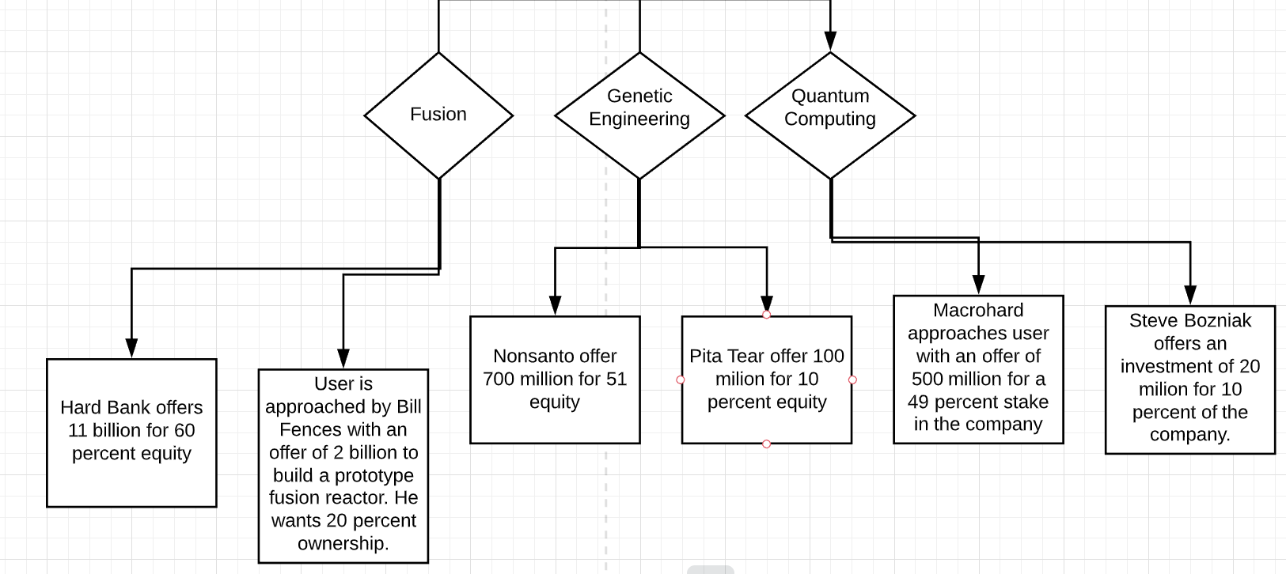
Industry Selection
There are three choices for industry
Each industry has two different initial financing options
Each industry has its own set of deadlines and objectives

Slide 13
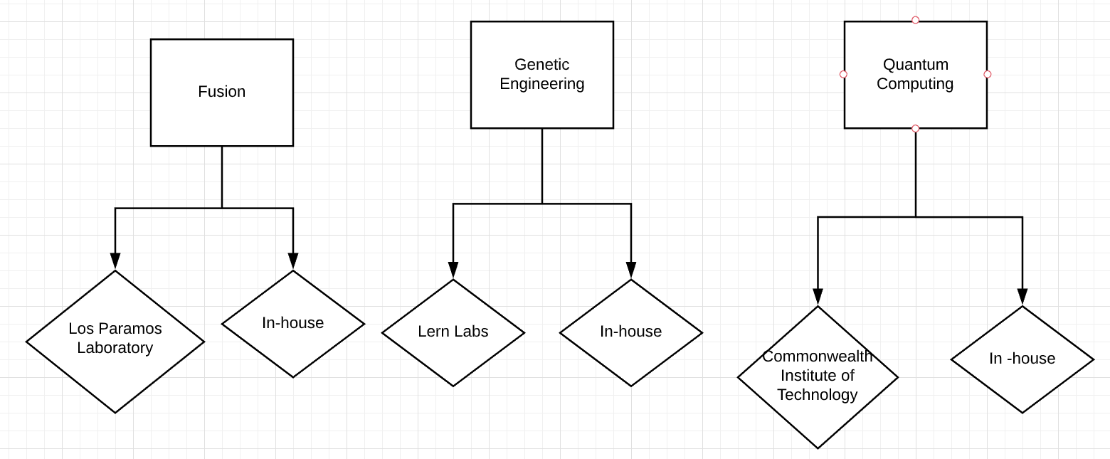
R&D
The plot revolves around technical intensive industries
The user gets to decide whether to do research in-house or through an outside lab
Costs and time depend on the choices the player makes

Slide 14
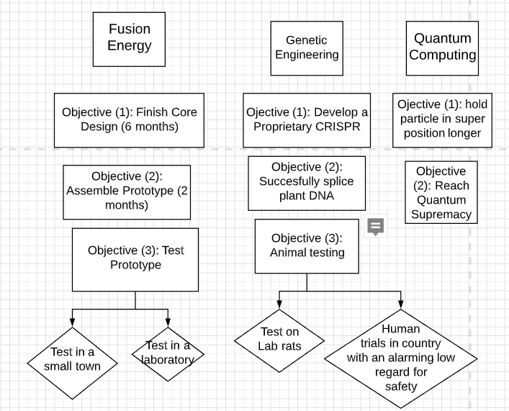
Objectives

